Slide 1
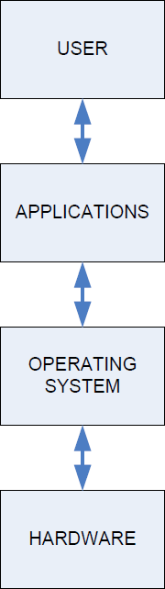

Computing: System access
6
Access is layered
  Each layer is isolated
If we install new hardware
  User/applications, OS: no change
  Install device drivers
If we install new software
− Hardware, OS: no change
Software should be supported by OS
−
If we change OS
  Compatible applications, hardware

Slide 2
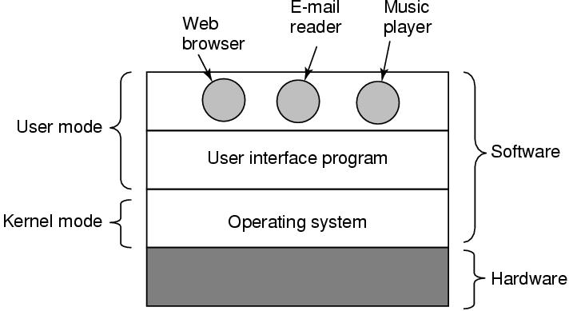
Computing: System Layers and the OS
7
OS is a (mega) software program
  Runs on ‘hardware’
  Intermediary / interface between ‘user’ and ‘hardware’
  ‘User’ programs run on top of the OS

Slide 3
OS: Goals and functions
8
Make the computer hardware easy to use
  Boot up, initialize hardware, set up system resources
  Present methods for easy interaction
Ease the solving of user problems
Control and execute ‘user’ / ‘application’ programs
Use the computer hardware in an efficient manner
  Multi-tasking
  Multi-user

Slide 4
OS: Services – General
16
Power ON
↓
BIOS
↓
OS Bootloader
↓
OS Kernel
↓
User programs
Various services provided by an OS:
  System boot-up and access
    Device initialization, handling
    ‘Drivers’ for various devices – disks, network, CD-ROMs, etc.
  I/O and files
    Handling I/O between various devices
    Handling disks, file-systems, etc.
  Program execution
    Loading and running executable in memory, handling exits / exceptions
  System management
    Resource ownership and management
    Managing access credentials (user-logins, etc.)

Slide 5
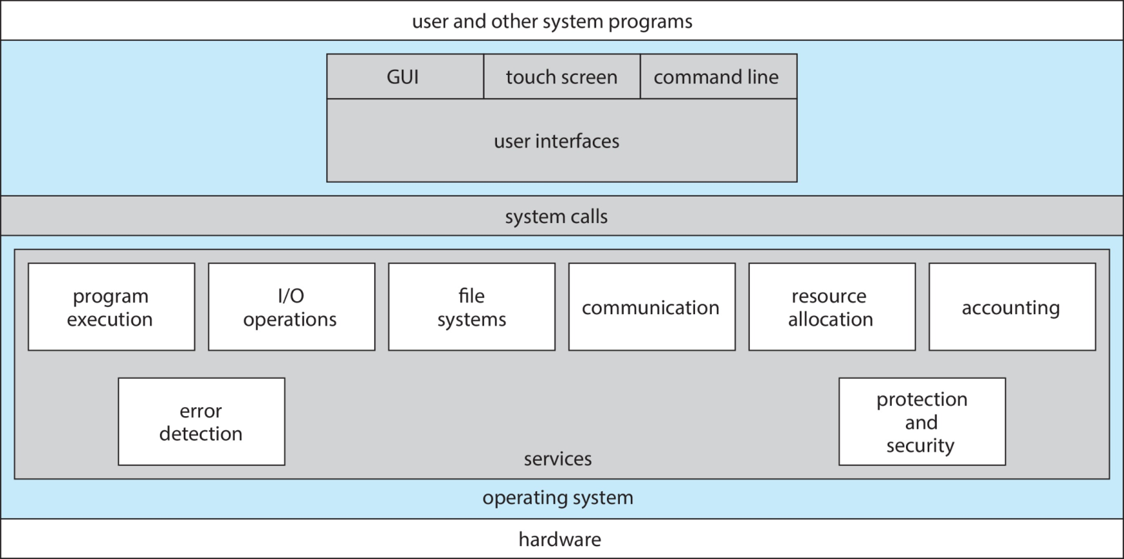

OS: Services illustrated
18

Slide 6
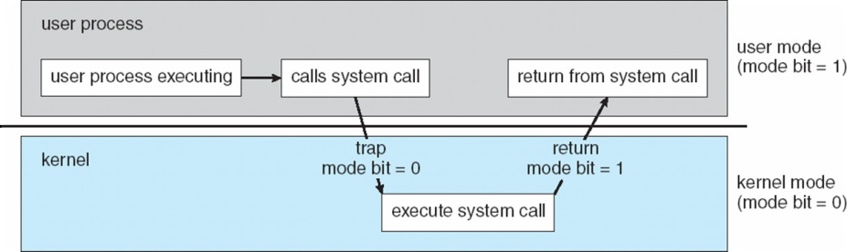
OS: Operative modes (1/2)
19
OS run creates 2 modes of operation:
  User mode
●
Controls interface between user and system
−
Kernel mode
●
Controls system and hardware resources
Mode changes from “user” to “kernel”
  Done by system calls

Slide 7
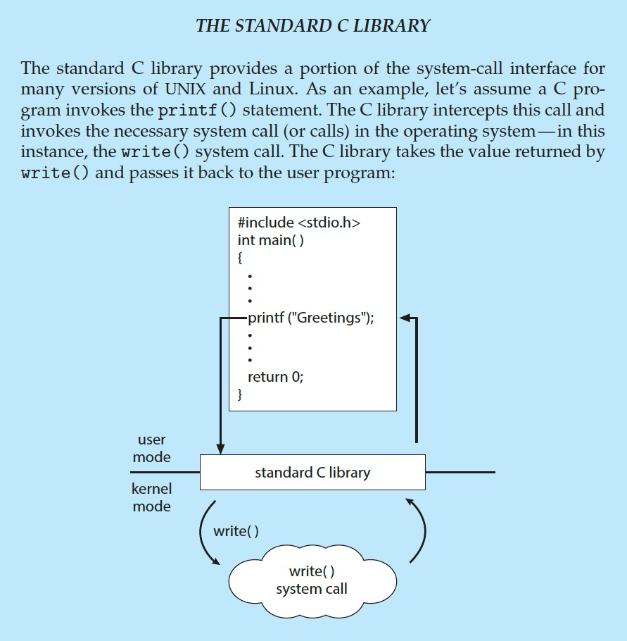
OS: Operative modes (2/2)
20
System call illustration for C’s ‘printf’

Slide 8
OS: Components
22
Software bundle, containing:
  ‘Kernel’
    Central control program/process running at all times on the computer
  System programs
    File-system stacks, Network stacks, UI components, Shells, etc.
  Application programs
    Browsers, Email clients, Word processors, Office suites, IDEs, etc.
  User-created programs
    ‘exes’ created by programmers, Web programs, etc.

Slide 9
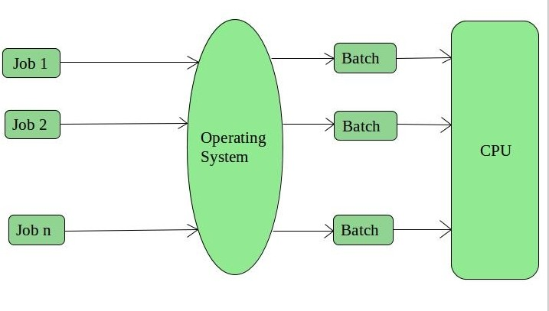
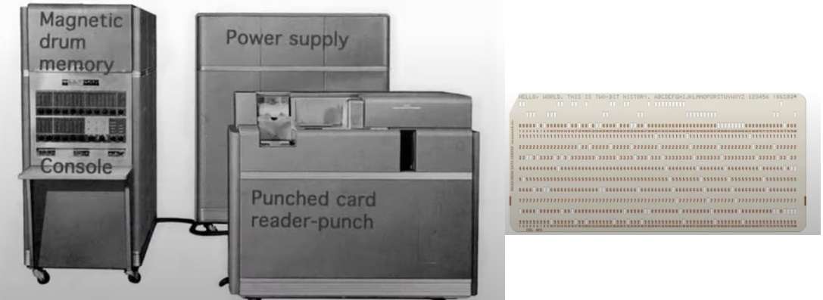
OS type: Batch OS
29
No direct user-computer interaction
Each user prepares their job, submits it in a job queue
Operator sequences jobs in ‘batches’

Slide 10
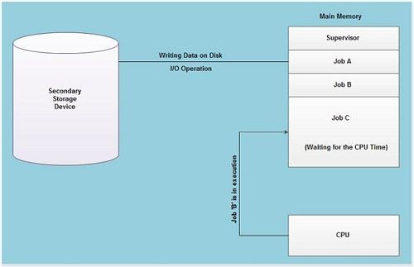
OS type: Multi-programming OS
30
Used to execute more than 1 job simultaneously
Increases CPU utilization – always 1 job to execute
Makes use of job and CPU scheduling

Slide 11
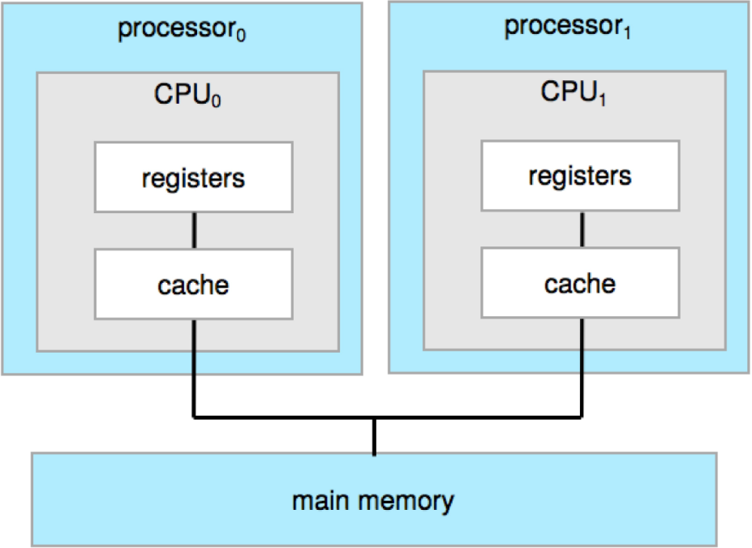
OS type: Multi-processing OS (1/3)
32
Multiple processors tightly coupled to each other
True multi-tasking – executes multiple jobs at once
Failure resilience – If 1 CPU fails, other takes jobs up

Slide 12
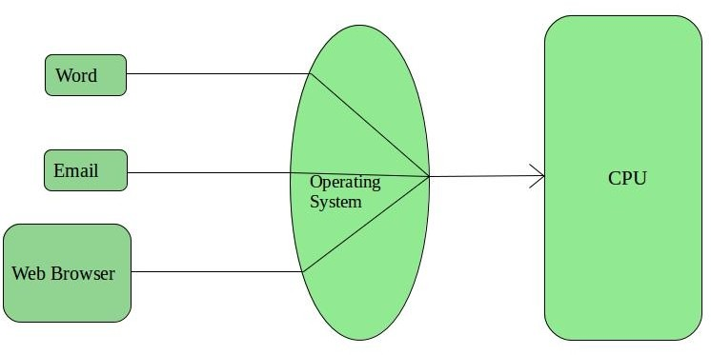
OS type: Time-sharing OS
31
Each job given some time to execute on CPU
Also called multi-tasking system
Introduces concept of time-slice or time-quantum

Slide 13
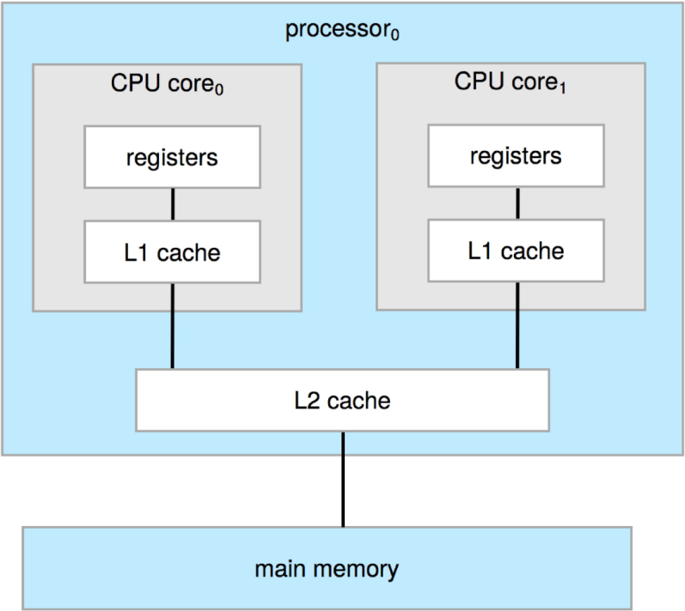
OS type: Multi-processing OS (2/3)
33
Multi-core designs also possible
Thanks to advances in VLSI Tighter coupling
−
−

Slide 14
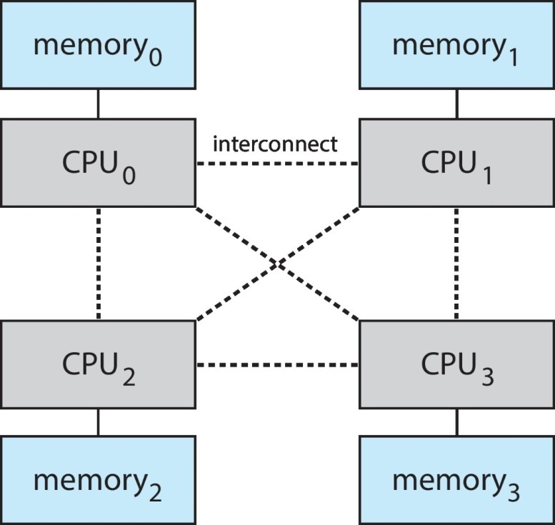
OS type: Multi-processing OS (3/3)
34
Non-uniform memory access (NUMA) designs
Scalable approach to multi-compute Intelligent software to optimize system usage
−
−

Slide 15
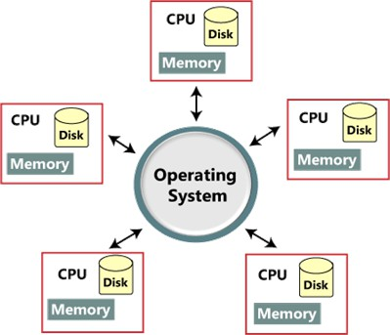
OS type: Distributed OS
35
Aggregation of independent systems
  Each with its own CPU, memory, etc.
Loosely coupled systems
  Connected via interconnects (communication networks)

Slide 16
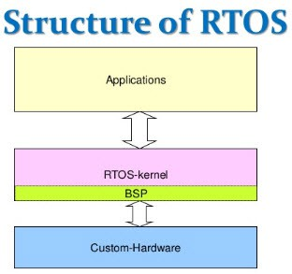
OS type: Real-time OS
37
OSes that serve needs of real-time systems
Response time is bounded – hard or soft
  Time taken to process and respond to inputs
Applications
  Missile control, air traffic systems, air bag systems

Slide 17
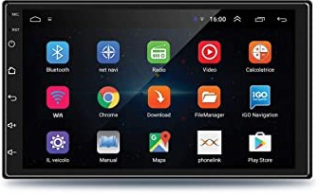
OS type: Embedded OS
38
OSes that are built into the circuitry of systems
  Specialized for specific functions
Found in smart-phones, automobiles, medical equipment
Examples:
  Android, Embedded Linux, Win CE

Slide 18
Concept: Real-time systems
7
Systems defined by constraint(s) on
  Event to System-response time
Systems that guarantee response
  Within specified time constraints (called ‘deadlines’)
Formal definition
  A real-time system is one which controls an environment by receiving data, processing it, and returning the results sufficiently quickly to affect the environment at that time
Usually used for mission-critical, high-consequence systems

Slide 19
Concept: RTOS
8
A real-time operating system (RTOS) is an OS
  Intended to serve real-time applications on real-time systems
Prime characteristics:
  High level of consistency regarding time taken to complete a task
  Low ‘jitter’ – variability in response time
  Deadlines met deterministically by proper task scheduling
  Minimal interrupt and thread-switching latency
Hard vs Soft real-time
  Hard real-time: Late response is a ‘wrong’ response
  Soft real-time: Late response can be tolerated within limits

Slide 20
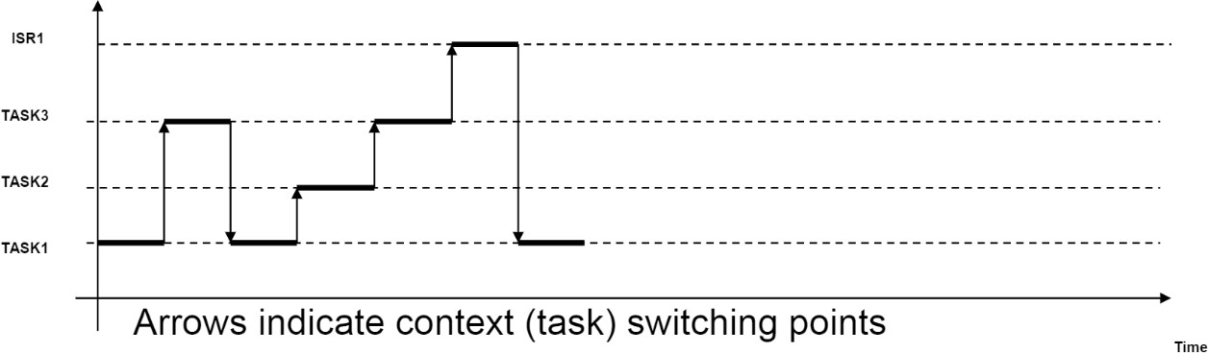
Architecture: RTOS
30
RTOS (Real-time operating system)
  Executes service code functions as individual tasks
    Tasks (could) have priority attributes
  Provides task creation, deletion facilities
Runs a scheduler (usually part of kernel)
  Decides the time sequence of tasks to run
  Slices CPU time across multiple tasks
    Switches tasks from slice to slice
Provides signaling services
  Send(), Wait()

Slide 21
RTOS: Partitioning and Concepts
31
Code partitioned into:
  ISR code
  Service code (called Task code)
  Main code
ISR code
  Send a unique signal (per device)
Task code
  Wait for device-unique signal
  Run the device code
Main code
  Initialize system
  Start all tasks
Concepts
  Task
    A concurrent activity
    Has its own thread of control
      With its own stack, context, etc.
  Semaphore
    An inter-task communication mechanism for synchronization
    A mechanism to keep track of resource usage
  Mutex
    A locking mechanism to resolve
      Conflicting requests from different tasks
      For the same resource

Slide 22
RTOS: Code snippets
32
Interrupt code
Main and task code
void interrupt Handle_Dev1()
{
Send_Signal1();
}
void Task1()
{
Wait_for_Signal1(); Service_Device1();
}
void TaskN()
{
Wait_for_SignalN(); Service_DeviceN();
}
…
void interrupt Handle_DevN()
{
Send_SignalN();
}
void main(void)
{
// Start Task1
…
// Start TaskN
}

